Slide 1
🍕 MENU
RESTAURANT
ORDER, KITCHEN
& BILLING SYSTEM
Choose food & quantity
👨‍🍳 KITCHEN
Track the customer order
Student Name: G.Rithwika [2620090117]
K.Greshma [2620030460]
Faculty Guide: V.GopiKrishna
🧾 BILLING
Calculate the final amount
Restaurant Order, Kitchen & Billing System • 1

Slide 2
1. Introduction
A simple Java system that connects ordering, kitchen processing and billing.
🍽️ ORDER
👨‍🍳 KITCHEN
🧾 BILLING
Customers select food items and enter quantities.
The program stores the order and calculates each item cost.
The ordered items are displayed clearly for the kitchen.
This helps staff see what needs to be prepared.
The system adds item totals and generates the final bill.
It reduces manual calculation.
Restaurant Order, Kitchen & Billing System • 2

Slide 3
2. Problem Statement
Manual restaurant processes can be slow and confusing.
• Orders may be written or communicated manually.
• Calculating prices and totals by hand can cause mistakes.
• Kitchen staff need a clear view of the customer's order.
• Managing several food items and quantities takes extra time.
• A simple computerized system can bring these steps together.
Restaurant Order, Kitchen & Billing System • 3

Slide 4
3. Objectives
What our project aims to achieve.
01 Easy Ordering
02 Kitchen View
Allow users to select food items and quantities.
Display the order in a simple kitchen-friendly format.
03 Automatic Billing
04 Less Manual Work
Calculate item totals and the final bill.
Reduce repeated calculations and order confusion.
Restaurant Order, Kitchen & Billing System • 4

Slide 5
4. Existing System
How the process is commonly handled without our program.
📝 1. TAKE ORDER
🗣️ 2. TELL KITCHEN
🧮 3. CALCULATE BILL
Staff note the customer's food choices and quantities.
The order is passed to the kitchen manually.
Prices are added manually before giving the bill.
Restaurant Order, Kitchen & Billing System • 5

Slide 6
5. Proposed System
Our Java program combines the main restaurant tasks.
1 View Menu
2 Place Order
3 Send to Kitchen
4 Generate Bill
Show food items and prices.
→
Select item and quantity.
→
Display the complete order.
→
Calculate and show total.
Restaurant Order, Kitchen & Billing System • 6

Slide 7
6. System Architecture
Simple flow of data through the Java application.
CUSTOMER
JAVA PROGRAM
KITCHEN
BILLING
Chooses food & quantity
→
Processes order
→
Receives order
→
Calculates total
Input → Processing → Kitchen Order → Bill Output
Restaurant Order, Kitchen & Billing System • 7

Slide 8
7. Functionalities
Main features included in the Java program.
✓ Display food menu
✓ Select food item
✓ Enter quantity
✓ Calculate item price
✓ Prepare kitchen order
✓ Generate final bill
✓ Show total amount
✓ Exit the program
Restaurant Order, Kitchen & Billing System • 8

Slide 9
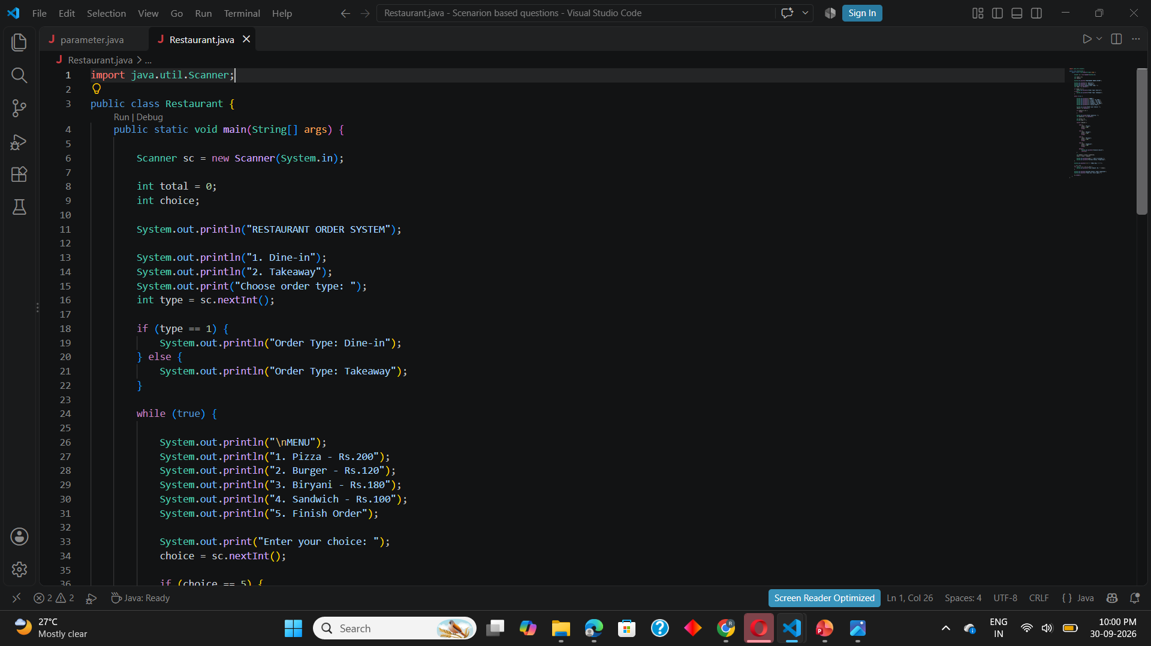
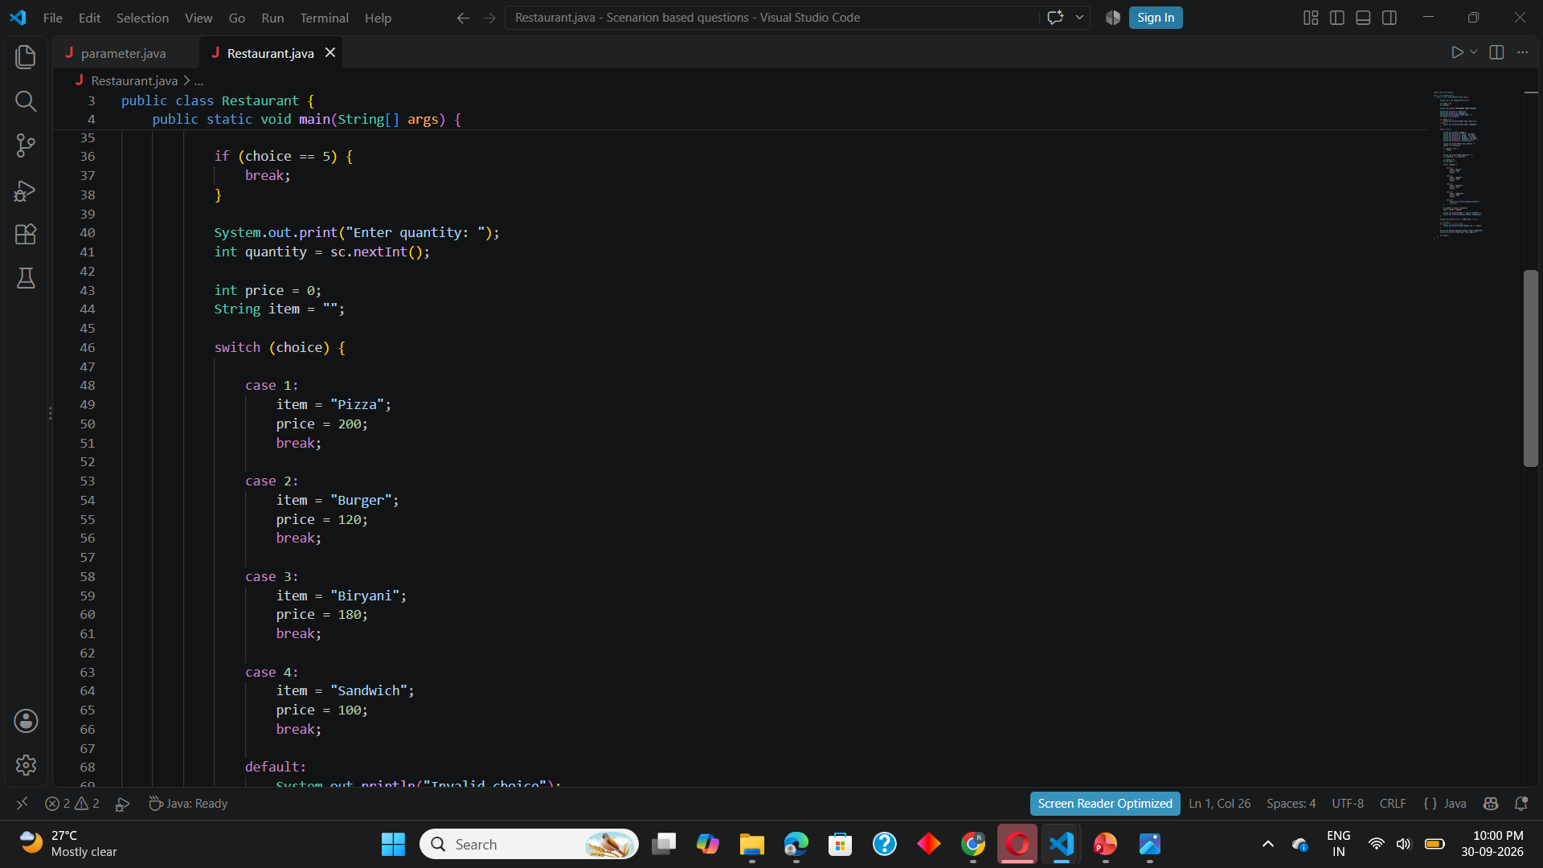
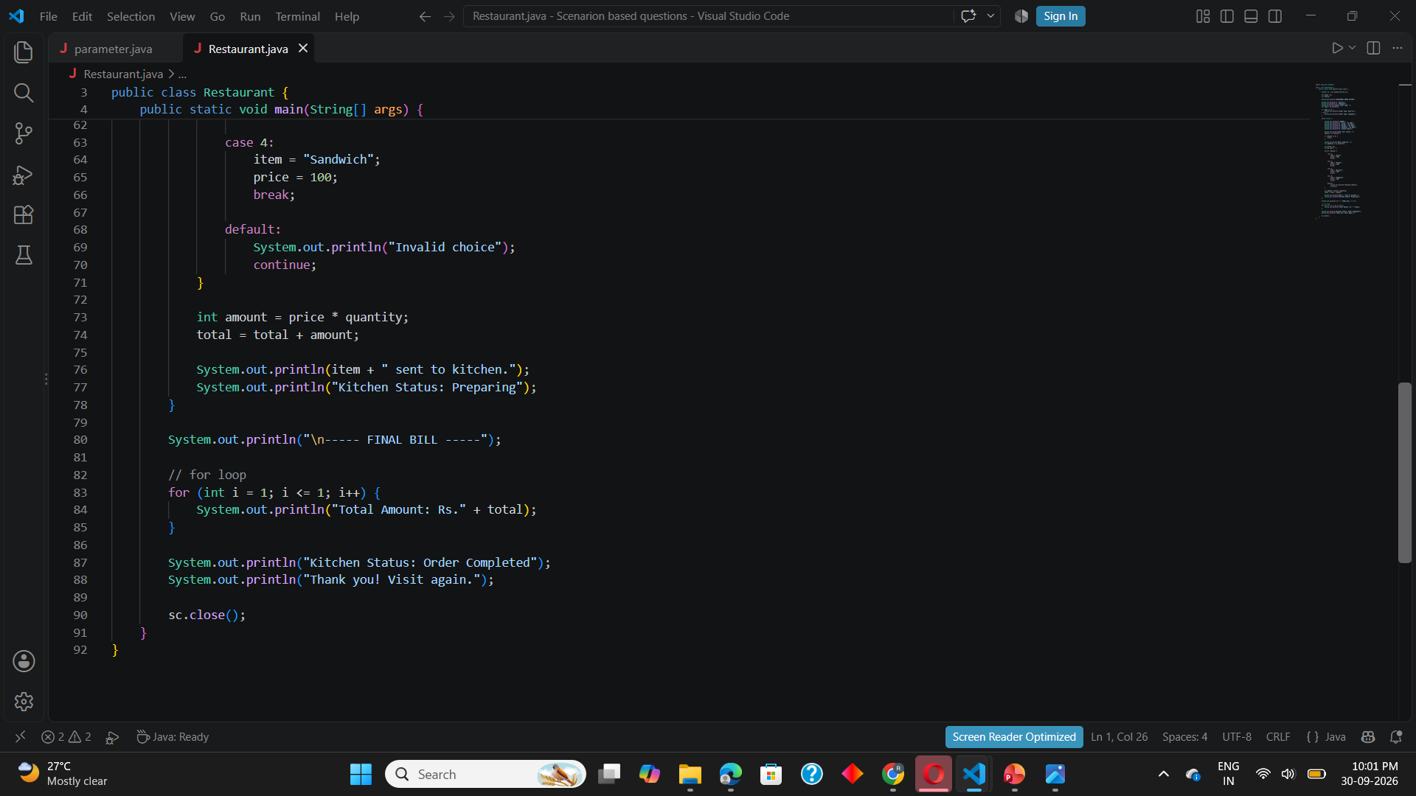
8. Implementation – Java Code
Use these sections as the code screenshots in the final PPT.
MENU + PRICES
ORDER + BILL
String[] items = {"Pizza", "Burger", "Biryani", "Sandwich"};
int[] price = {200, 120, 180, 100};
System.out.println("1. Pizza - Rs.200");
System.out.println("2. Burger - Rs.120");
System.out.println("3. Biryani - Rs.180");
System.out.println("4. Sandwich - Rs.100");
int total = 0;
total += price[choice - 1] * quantity;
System.out.println("KITCHEN ORDER");
System.out.println("Item: " + items[choice - 1]);
System.out.println("Quantity: " + quantity);
System.out.println("TOTAL: Rs." + total);
Replace these sample panels with screenshots of your actual tested Java code before submission.
Restaurant Order, Kitchen & Billing System • 9

Slide 10
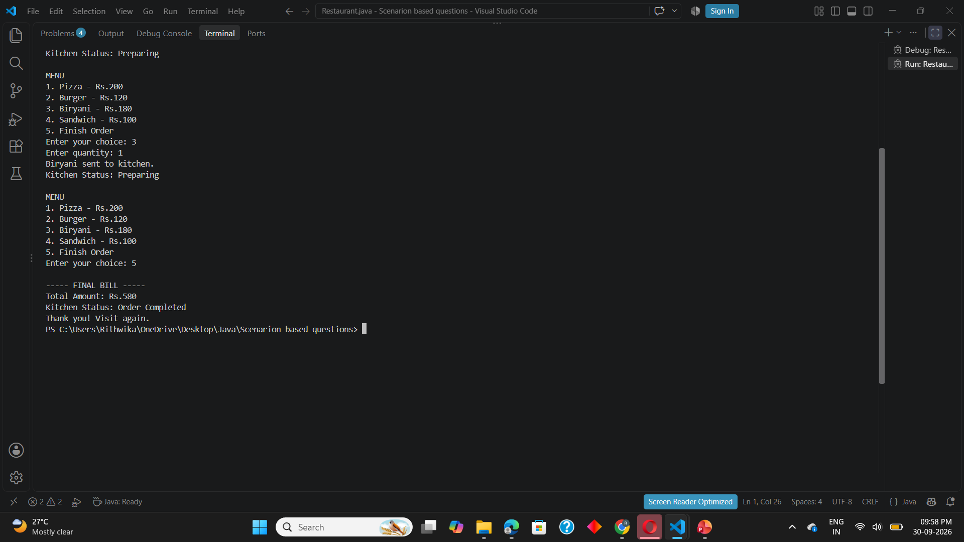
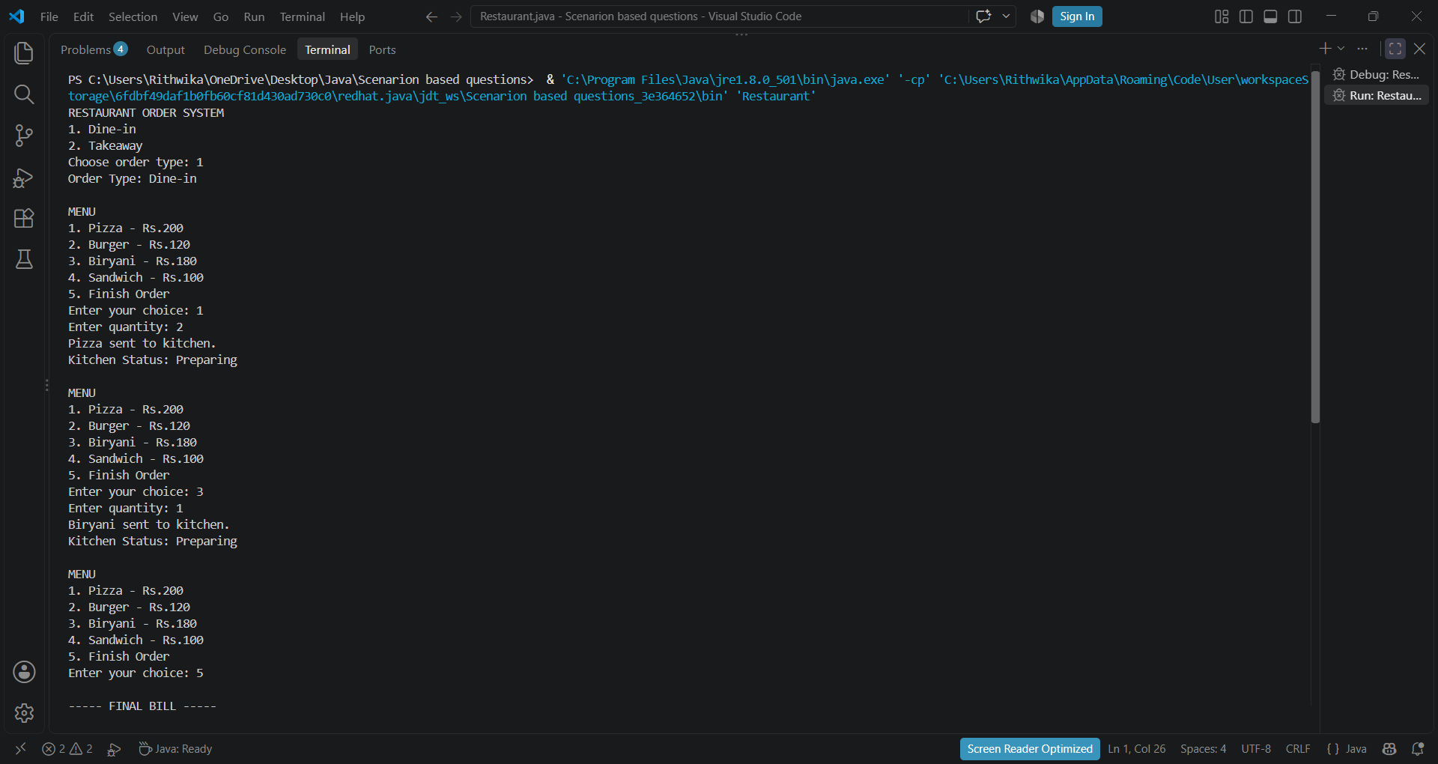
9. Output Screenshots
Add screenshots from the working Java program here.
MAIN MENU
KITCHEN ORDER
FINAL BILL
INSERT
SCREENSHOT
INSERT
SCREENSHOT
INSERT
SCREENSHOT
Restaurant Order, Kitchen & Billing System • 10

Slide 11
10. Future Scope
Possible improvements for a larger version of the project.
🖥️ GUI
🗄️ DATABASE
📱 ONLINE ORDER
Java Swing / JavaFX interface
Store menu, orders and bills
Allow customers to place orders digitally
💳 PAYMENT
🔔 STATUS
👤 LOGIN
Add digital payment options
Show order preparation status
Separate customer and staff access
Restaurant Order, Kitchen & Billing System • 11

Slide 12
11. Conclusion
A small project that brings three restaurant tasks into one Java program.
ORDER
KITCHEN
BILLING
Food selection and quantities are handled in one place.
The order can be displayed clearly for preparation.
The total is calculated automatically from the order.
The project demonstrates how Java can automate a real-world restaurant workflow.
Restaurant Order, Kitchen & Billing System • 12

Slide 13
THANK YOU
Restaurant Order, Kitchen & Billing System
Questions?
Restaurant Order, Kitchen & Billing System • 13

